Slide 1
Artificial Intelligence and Machine Learning
6CS012 - Week 03 –Sunita Parajuli

Slide 2
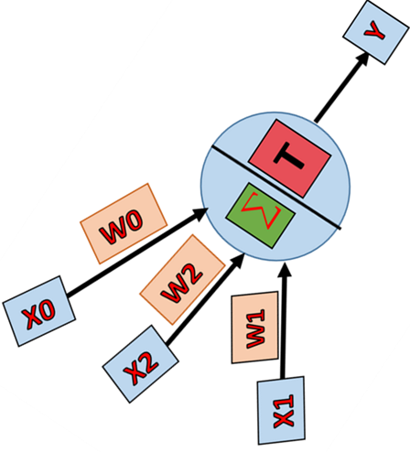
The Perceptron Model.
The Perceptron, introduced by Frank Rosenblatt and later corrected by Minsky and Papert, extends the McCulloch-Pitts neuron
by incorporating learnable numerical weights and
an adaptive learning process.
It serves as a Linear Binary Classifier, dividing data into two categories based on a linear decision boundary.
Reminds you of something?
3/7/2025
‹#›

Slide 3
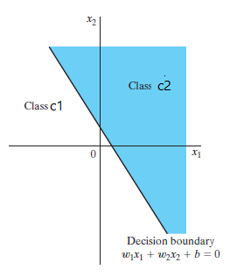
Perceptron Algorithm
The perceptron algorithm is built around a single neuron and it is limited to performing pattern classification with only two classes (for example: 0 and 1 class or 1 and -1 class, called as binary class)
The perceptron is the simplest form of a neural network used for the classifying linearly separable patterns. Patterns that can be separated by a hyperplane are called linearly separable patterns.

Slide 4
Perceptron can be trained to show behavior of AND function and OR function because both are linearly separable.
x₂
x₂
x₂
1
1
1
0
0
1
x₁
x₁
x₁
0
0
0
1
0
1
Fig: AND Function
Fig: XOR Function
Fig: OR Function

Slide 5
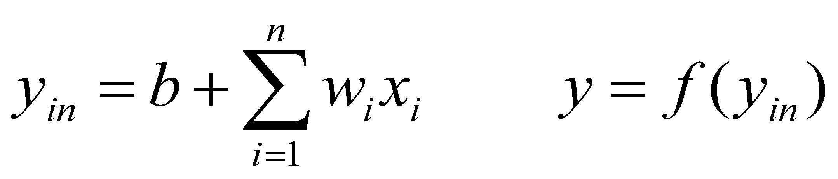
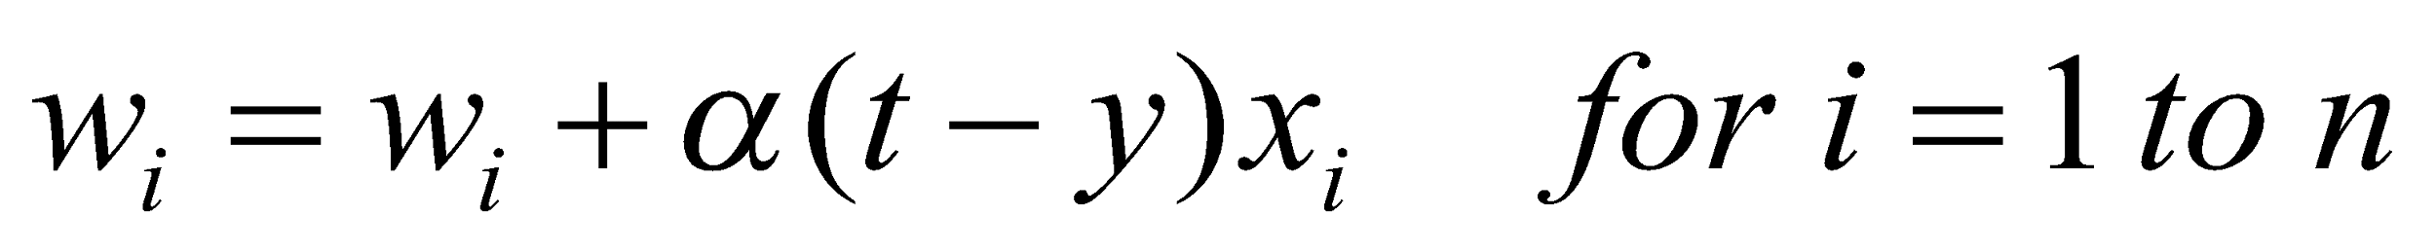
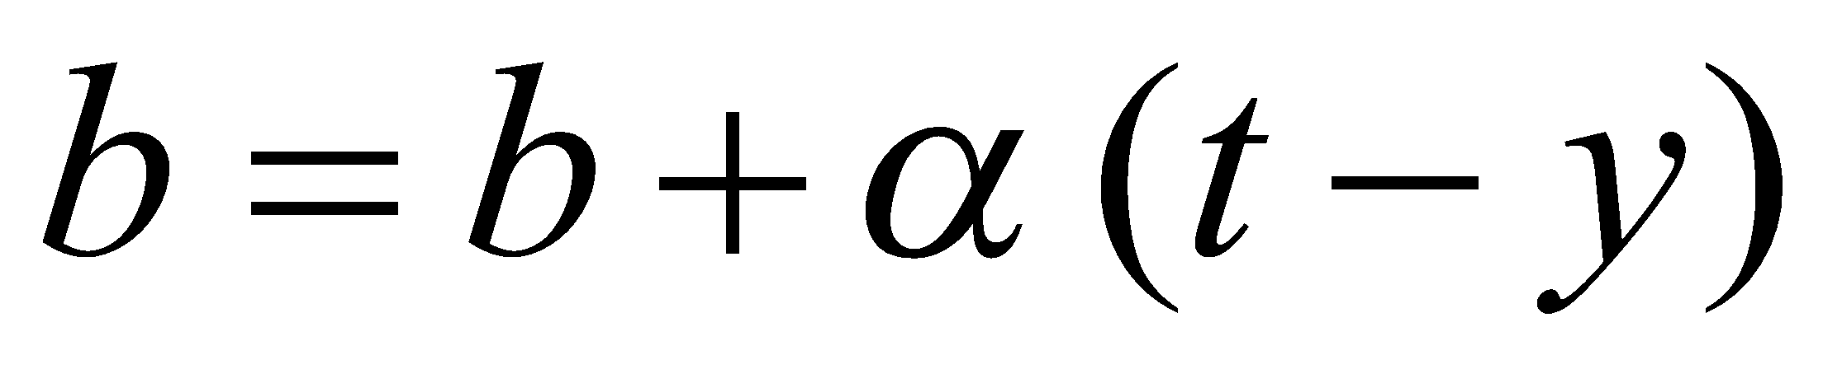


Perceptron Learning Algorithm
Initialize all weights (w) and bias (b) to zero
For each training vector x and actual target ‘t’ (desired output)
Compute output y from y_{in} using activation function ‘f’:
Update weights as:
Update bias as:
Repeat updating weight
and bias until desired output.
x₁
w₁
w₂
y
Note: α is learning rate, 0 <= α <= 1
x₂
b

Slide 6
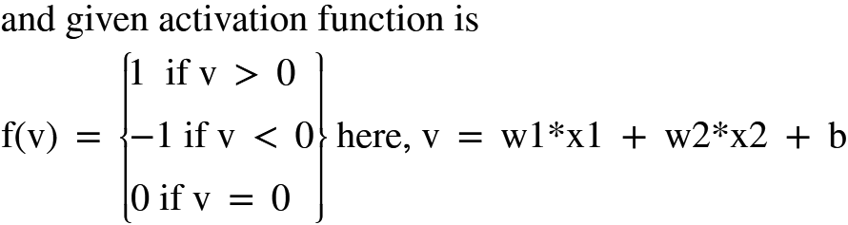
Realizing AND gate using One Neuron (Perceptron Algorithm)
Example
Train the following perceptron by using given training set
x₁
w₁
x₁ | x₂ | Target (t) x1 AND x2
1 | 1 | 1
1 | -1 | -1
-1 | 1 | -1
-1 | -1 | -1
w₂
y
x₂
b

Slide 7
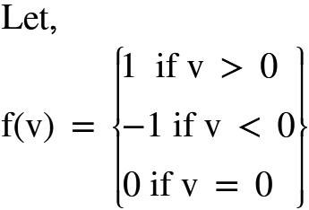
x₁
w₁
Solution: =1
Iteration#1
w₂
y
x₂
w2 = w2 + *(target-y)*x2
b
Input(x1, x2, target)
v = w1*x1 + w2*x2 + b
b = b + *
(target-y)
Input | w₁ (old) | w₂ (old) | b (old) | v | y | w₁ (new) | w₂(new) | b(new)
(1,1,1) | 0 | 0 | 0 | 0 | 0 | 0+1*1*1=1 | 0+1*1*1=1 | 0+1*1=1
(1,-1,-1) | 1 | 1 | 1 | 1 | 1 | 1+1*-2*1=-1 | 1+1*-2*-1=3 | 1+1*-2=-1
(-1,1,-1) | -1 | 3 | -1 | 3 | 1 | -1+1*-2*-1=1 | 3+1*-2*1=1 | -1+1*-2=-3
(-1,-1,-1) | 1 | 1 | -3 | -5 | -1 | 1+1*0*-1=1 | 1+1*0*-1=1 | -3+1*0=-3
y = f(v) i.e. activation function applied to v
w1 = w1 + *(target-y)*x1

Slide 8
Iteration #2
Thus, Final Neuron is:
Input | w₁ (old) | w₂ (old) | b (old) | v | y | w₁ (new) | w₂(new) | b(new)
(1,1,1) | 1 | 1 | -3 | -1 | -1 | 1+1*2*1=3 | 1+1*2*1=3 | -3+1*2=-1
(1,-1,-1) | 3 | 3 | -1 | -1 | -1 | 3+1*0*1=3 | 3+1*0*-1=3 | -1+1*0=-1
(-1,1,-1) | 3 | 3 | -1 | -1 | -1 | 2+1*0*-1=3 | 3+1*0*1=3 | -1+1*0=-1
(-1,-1,-1) | 3 | 3 | -1 | -7 | -1 | 3+1*0*-1=3 | 3+1*0*-1=3 | -1+1*0=-1
x₁
w₁=3
w₂=3
y
x₂
No update in weights and bias so solution is obtained
b=-1

Slide 9
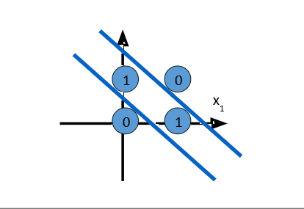
Try Realizing XOR gate using the perceptron
x₁ | x₂ | Target (t) x1 AND x2
1 | 1 | -1
1 | -1 | 1
-1 | 1 | 1
-1 | -1 | -1
x₁
w₁
w₂
y
x₂
b

Slide 10
XOR Problem
single layer perceptron can be trained to classify patterns that is linearly separable.
However, XOR function is non-linearly separable as shown in the figure given below. Thus, we can not train single layer perceptron for XOR function. This, problem is called XOR Problem.
1
0
x₁
0
1

Slide 11
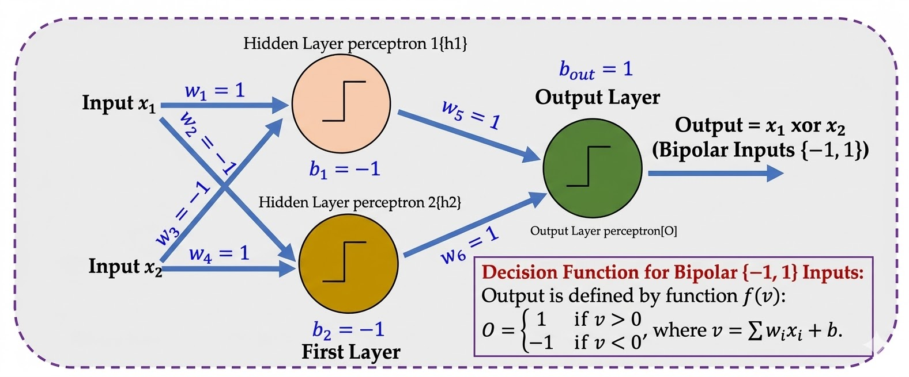
Solving XOR With Multilayer Perceptron

Slide 12
Solving XOR with multi layer perceptron
Inputs (x1​,x2​) | Hidden 1 v1​(1x1​−1x2​−1) | h1​ Outputf(v1​) | Hidden 2 v2​(−1x1​+1x2​−1) | h2​ Outputf(v2​) | Output vout​(1h1​+1h2​+1) | Final Outputf (vout​) | Target
(1, 1) | 1(1) - 1(1) - 1 = -1 | -1 | -1(1) + 1(1) - 1 = -1 | -1 | 1(-1) + 1(-1) + 1 = -1 | -1 | -1
(1, -1) | 1(1) - 1(-1) - 1 = 1 | 1 | -1(1) + 1(-1) - 1 = -3 | -1 | 1(1) + 1(-1) + 1 = 1 | 1 | 1
(-1, 1) | 1(-1) - 1(1) - 1 = -3 | -1 | -1(-1) + 1(1) - 1 = 1 | 1 | 1(-1) + 1(1) + 1 = 1 | 1 | 1
(-1, -1) | 1(-1) - 1(-1) - 1 = -1 | -1 | -1(-1) + 1(-1) - 1 = -1 | -1 | 1(-1) + 1(-1) + 1 = -1 | -1 | -1

Slide 13
Any Questions?

